Slide 1
NATO FORCE INTEGRATION UNIT ESTONIA
Estonian School of Diplomacy
08 Nov 24
Wg Cdr Mike Gallagher RAF
Acting COM
NFIU EST

Slide 2
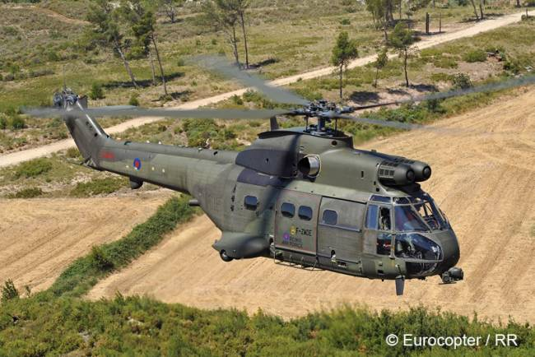
Introduction
Agenda
NFIU Founding
Adaptation post-Vilnius
Primary Role
Organisation
Annual Activity
Products
Network
Issues and Challenges
Conclusion

Slide 3
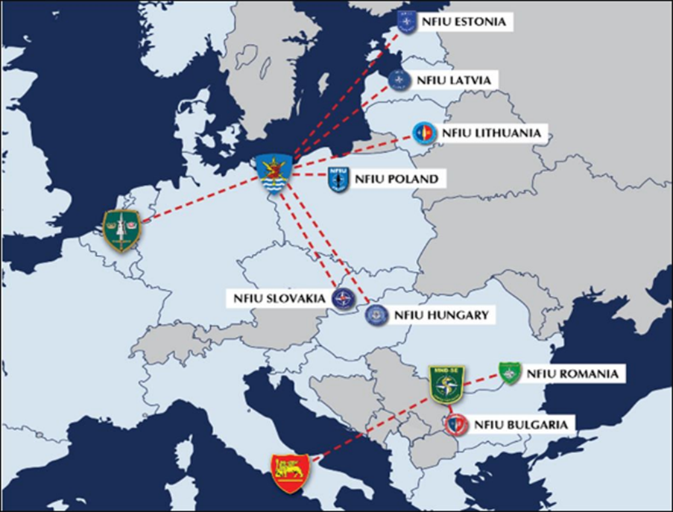
Foundation of the NFIUs
Russian aggressive and expansionist actions
2008 Georgia
2014 Ukraine
Wales Summit 2014
Readiness Action Plan
Enhancement of the NRF
Introduction of the VJTF
Activation of MNC NE
Development of the Graduated Response Plans
Foundation of the NFIUs

Slide 4
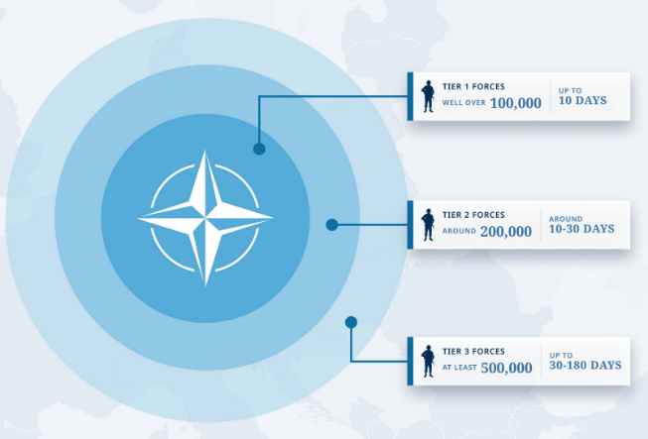
Adaptation of NATO after Vilnius
Deterrence and Defence of the Euro-Atlantic Area (DDA Family of Plans)
New ‘Family’ of Plans inc SASP, SSP, RP, etc.
NATO New Force Model
NRF ARF
Change from National to Multinational Logistics
Multi Domain Operations
HNS Concept
Joint Logistics Support Network (JLSN) Concept
Joint Logistics Support Group (JLSG) as RSOM COM
Notes:
Subordinate Strategic Plans

Slide 5
NFIU’s Primary Role…
The NFIU is to assist and facilitate the rapid deployment and sustainment of NATO and other Allied forces in their HN, in order to enhance Alliance responsiveness, whilst providing a permanent, visible, forward NATO presence in the east of SACEUR’s AOR from peacetime through crisis to conflict.
ACO DIRECTIVE 080-104
NATO FORCE INTEGRATION UNITS
Sep 24

Slide 6
NFIU is to contribute in their HN to the planning, coordination and trg for:
a. Development of RSN, Joint Logistics Support Networks (JLSNs) and Joint Logistics Support Areas (JLSA).
b. Development of Enablement SA.
c. Support…. RSOM / Rearward Movement Staging and Dispatch (RMSD) - and sustainment of Allied Combat Power.
d. Contribution to wider Situational Awareness and Understanding.
e. Support and involvement in all phases of the planning process as directed by JLSG, including fostering coherence with national defence plans.
ACO DIRECTIVE 080-104
NATO FORCE INTEGRATION UNITS
Sep 24

Slide 7
NFIU EST ORGANISATION
Command Group
Fill rate 80%
Commander OF-5
Greatest Concern
20 / 18 / 2*
As of 14.10.24
Acting Commander OF-4
SO (Coord) OF-4
Communication AD OF-2
2 / 2
SA (Administration) OR-9
LEGAD OF-1
SA (Registry) CIV
HNS AD CIV
J1/8 Personnel & Finance Branch
J2 Intelligence Branch
J3 Operations Branch
J4 Logistics Branch
J6 Operational Communications & Information Systems Branch
4 / 3
J1 SO J1 (Personnel) OF-3
J2 BH (Intelligence) OF-4
J3 BH (Operations) OF-4
J4 BH (Logistics) OF-4
Since 01.08.2021
UNF
J6 BH (Operational CIS) OF-1
TEMP
J1 SA (Admin/APMS) OR-9
J2 SA (Coordination) OR-7
J3 SA (Coordination) OR-8
J4 SA (Coord/LOGFAS) OR-8
J6 SA (Operations) OR-8
1 / 1
J8 SO (Finance) CIV
J2 SH (Intel Plans) OF-3
J3/5 SH (Land Plans) OF-4
J4 SH (Log Operations) OF-3
J6 SA (Network Support & Management) OR-2
VNC
VNC
J2 SO (Intel Analyst) OF-3
J3/5 SO (Air Plans) OF-4
J4 SO (Log Plans) OF-3
Since AUG 2019
UNF
2 / 2
J2 SO (Intel Analys) OF-2
Since 2015
UNF
J3/5 (Maritime Plans) OF-4
J4 SO (Sup &Services) OF-3
J2 SA (CCIRM) OR-7
UNF
J3/5 (CIMIC Plans) OF-3
J4 SO (Med Ops&Plans) OF-2
1 / 1
J2 SO (CI / HUMINT) OF-4
J3/5 SO (SOF Plans) OF-3
J4 SH (M&T Ops) OF-3
J2 SO (Security) OF-2
J3/7 SH (TE & LL) OF-4
J4 SO (Land Mov/LOGFAS) OF-3
1 / 1
Total 41 posts
J3/7 SO (E & LL) OF-2
J4 SO (Air Mov) OF-4
Filled 33
Unfilled 8
J4 SH (Engineering Ops) OF-3
Since 2015
UNF
NATO UNCLASSIFIED
3 / 3

Slide 8
NFIU 24 Snapshot
2024
OLAM
CUOE
OLAM
CUOE
A2AD Seminar
TTX 1
MoD
Staff-Ride 1
TTX 2
FLF
Staff-RideX
MLI Symposium
Collective Trg
Collective Trg
Collective Trg
Collective Trg
SAB
SAB
SAB
SAB
Battle Group Briefs
SAB
SAB
SAB
SAB
Battle Group Briefs
SAB
SAB
SAB

Slide 9
NFIU Estonia Ad Hoc Activity
Support all visiting units to Estonia
Organise PDSS, recces
Provide RLS (Office space, CIS, advice, coffee, transport)
Networking & Signposting
Spt to local Exs
Conceptual Work
Document Filtering
Wider spt to EDF HQ
Personnel Development (sports, social, AT, families)

Slide 10
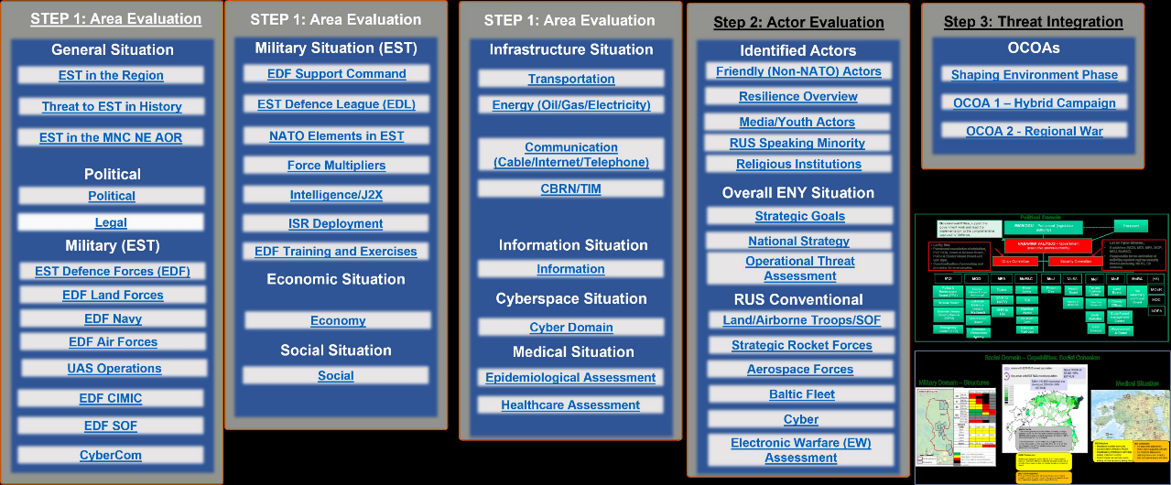
CUOE Table Of Content

Slide 11
CUOE Data Sample (1/2)

Slide 12
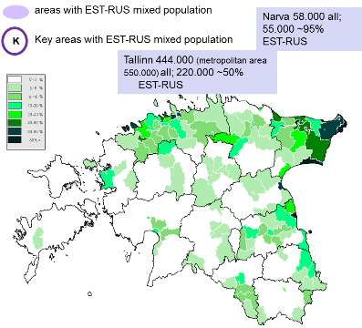
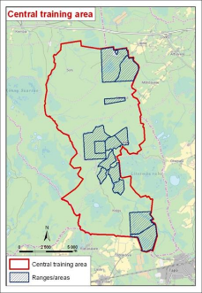
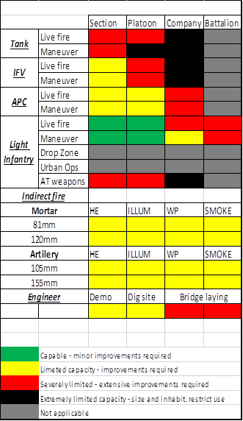
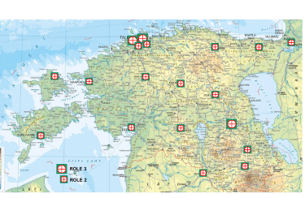
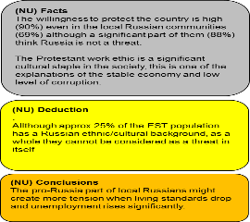
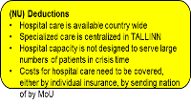
CUOE Data Sample (2/2)
Social Domain – Capabilities: Social Cohesion
Military Domain – Structures
Medical Situation

Slide 13
Operations and Logistics Aide Memoire (OLAM) Introduction
Providing an initial overview and quick reference information for infrastructure and services in Estonia. This information is updated twice annually so it is recommended for any final planning to verify the current status of facilities.
General Info | Sea Ports | Air Ports
Host Nation Support Overview | Paldiski South Harbour | Tallinn International Airport
Permit to Deploy/Diplomatic Clearance Requests | Paldiski North Harbour | Tartu Airport
Road Networks | Muuga Harbour | Kuressare Airport
Rail Networks | Old City Harbour | Kardla Airport
Medical Support Overview | Dirhami Harbour | Ruhnu Airfield
Civilian Hospitals | Leppneeme Harbour | Ämari Lennubaas Airbase
Military Clinics | Miiduranna Harbour | Parnu Airport
 | Paljassaare Harbour
 | Rohuneeme Harbour
 | Kunda Harbour
 | Virtsu Harbour
 | Roomassaare Harbour
 | Miinisadam Naval Base
Notes:
Hyperlink to the Appropriate Slide

Slide 14
NFIU EST Networks
NATO
XXXXX
Joint Support and Enabling Command
LAND
HQ
SHAPE
NATO Response
Force (NRF)
MARFOR
EUR
USAFE
NCS
Very High Readiness Joint Task Force
eFPC
Op CABRIT
USAREUR
NAVEUR
Land Command Izmir
Allied Movement Coordination Centre
V Corps
21st TSC
XXXX
Maritime
Command Northwood
NCS
JFCBS
US ODC
SOF ODB
MNC/NE
X
enhanced Forward Presence
eBaltic Air Policing
CTC
Air Command
Ramstein
JLSG BS
Multinational Division North
NCS
NATO Joint
Warfare
Centre
NS HQ
OTHER NFIUs
NATO STRATCOM
CoE
NATO Cooperative Cyber Defence
Security CoE
NFIU EST
NATIONAL/
Multilateral
International Centre for Defence and Security
Ministry of Defence
Ministry of
the Interior
Internal
Security Service
Police & BG
Bureau
Ambassadors and Defence Attachés
Baltic
Defence
College
CHIEF OF
DEFENCE
Other Ministries
Foreign Intelligence
Service
Rescue
Board
State
Department
Health Board
MIL INTEL Center
International Centre
EDF HQ
Government Office
Primary network
Second line network
Third line network
ESTONIAN
DEFENCE
LEAGUE
SPECIAL
FORCES
AIR
FORCE
SUPPORT
COMMAND
CYBER
COMMAND
GROUND
FORCE UNITS
NAVY
Network in development

Slide 15
Issues and Challenges
Lack of deployable capability
Reduction in personnel
Role in Crisis and Conflict

Slide 16
What is success for NFIU Estonia?
Coherence between RP-C and NHDP both in peacetime and crisis.
Main Effort
Supporting Ex SIIL 25

